Slide 1
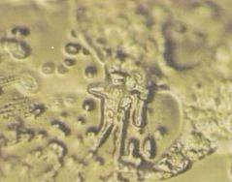
Poor & wretched Revelation 3:14-22
The Church at Laodicea

Slide 2
Poor & wretched Revelation 3:14-22
The Church at Laodicea
Smyrna and Philadelphia: persecution
Pergamum et Thyatira: compromise
Ephesus et Sardis: auto satisfaction

Slide 3
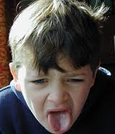
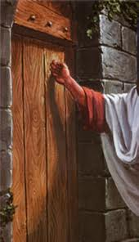
Poor & wretched Revelation 3:14-22
The Church at Laodicea

Slide 4
Poor & wretched Revelation 3:14-22
The Church at Laodicea
“To the angel of the church in Laodicea write:
These are the words of the Amen, the faithful and true witness, the ruler of God’s creation. I know your deeds, that you are neither cold nor hot. I wish you were either one or the other! So, because you are lukewarm—neither hot nor cold—I am about to spit you out of my mouth.

Slide 5
Poor & wretched Revelation 3:14-22
The Church at Laodicea
You say, ‘I am rich; I have acquired wealth and do not need a thing.’ But you do not realize that you are wretched, pitiful, poor, blind and naked. I counsel you to buy from me gold refined in the fire, so you can become rich; and white clothes to wear, so you can cover your shameful nakedness; and salve to put on your eyes, so you can see.

Slide 6
Poor & wretched Revelation 3:14-22
The Church at Laodicea
Those whom I love I rebuke and discipline. So be earnest and repent. Here I am! I stand at the door and knock. If anyone hears my voice and opens the door, I will come in and eat with that person, and they with me. To the one who is victorious, I will give the right to sit with me on my throne, just as I was victorious and sat down with my Father on his throne. Whoever has ears, let them hear what the Spirit says to the churches.”

Slide 7
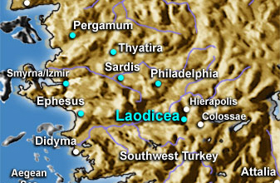
Poor & wretched Revelation 3:14-22
The Church at Laodicea

Slide 8
Poor & wretched Revelation 3:14-22
The Church at Laodicea
Banking
Textiles
Medicine

Slide 9
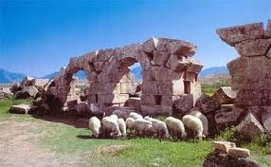
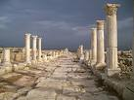
Poor & wretched Revelation 3:14-22
1.1 To the angel of the church at Laodicea
Hierapolis
Laodicea
Colossae

Slide 10
Poor & wretched Revelation 3:14-22
1.1 To the angel of the church at Laodicea
1.2 The description of the speaker
“These are the words of the Amen, the faithful and true witness, the ruler of God’s creation” (3:14b)

Slide 11
Poor & wretched Revelation 3:14-22
1.1 To the angel of the church at Laodicea
1.2 The description of the speaker
“These are the words of the Amen, the faithful and true witness, the ruler of God’s creation” (3:14b)
The “Amen”
“Whoever invokes a blessing in the land will do so by the one true God [Lit. “the God of ‘Amen’”]; whoever takes an oath in the land will swear by the one true God [Lit. “the God of ‘Amen’”]. For the past troubles will be forgotten and hidden from my eyes” (Isaiah 65:16)
(The God of truth – he who is totally trustworthy)

Slide 12
Poor & wretched Revelation 3:14-22
1.1 To the angel of the church at Laodicea
1.2 The description of the speaker
“These are the words of the Amen, the faithful and true witness, the ruler of God’s creation” (3:14b)
The “Amen”
For no matter how many promises God has made, they are “Yes” in Christ. And so through him the “Amen” is spoken by us to the glory of God. (2 Corinthians 1:20)
(The God of truth – he who is totally trustworthy)

Slide 13
Poor & wretched Revelation 3:14-22
1.1 To the angel of the church at Laodicea
1.2 The description of the speaker
“These are the words of the Amen, the faithful and true witness, the ruler of God’s creation” (3:14b)
The “Amen”
The faithful and true witness
John, to the seven churches …From Jesus Christ, who is the faithful witness (1:5)

Slide 14
Poor & wretched Revelation 3:14-22
1.1 To the angel of the church at Laodicea
1.2 The description of the speaker
“These are the words of the Amen, the faithful and true witness, the ruler of God’s creation” (3:14b)
The “Amen”
The faithful and true witness
The ruler (beginning) of God’s creation
The Son is the image of the invisible God, the firstborn over all creation. For in him all things were created: things in heaven and on earth, visible and invisible, whether thrones or powers or rulers or authorities; all things have been created through him and for him. He is before all things, and in him all things hold together. And he is the head of the body, the church; he is the beginning and the firstborn from among the dead, so that in everything he might have the supremacy. (Colossians 1:15-18)

Slide 15
Poor & wretched Revelation 3:14-22
1.1 To the angel of the church at Laodicea
1.2 The description of the speaker
1.3 The Prophetic message – “I know…”
I know your deeds, that you are neither cold nor hot. I wish you were either one or the other! So, because you are lukewarm—neither hot nor cold—I am about to spit you out of my mouth. You say, ‘I am rich; I have acquired wealth and do not need a thing.’ But you do not realize that you are wretched, pitiful, poor, blind and naked (3:15-17).

Slide 16
Poor & wretched Revelation 3:14-22
1.1 To the angel of the church at Laodicea
1.2 The description of the speaker
1.3 The Prophetic message – “I know…”
No commendation ! – Jesus saw everything that was going on. In the other churches he saw positive aspects – here…NOTHING!

Slide 17
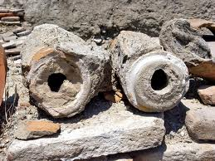
Poor & wretched Revelation 3:14-22
1.1 To the angel of the church at Laodicea
1.2 The description of the speaker
1.3 The Prophetic message – “I know…”
No commendation ! – Jesus saw everything that was going on. In the other churches he saw positive aspects – here…NOTHING!
Neither hot nor cold! – sickening!

Slide 18
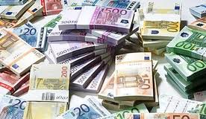
Poor & wretched Revelation 3:14-22
1.1 To the angel of the church at Laodicea
1.2 The description of the speaker
1.3 The Prophetic message – “I know…”
No commendation !
Invitation and reprimand
Laodicean analysis: ‘I am rich; I have acquired wealth and do not need a thing.’

Slide 19
Poor & wretched Revelation 3:14-22
1.1 To the angel of the church at Laodicea
1.2 The description of the speaker
1.3 The Prophetic message – “I know…”
No commendation !
Invitation and reprimand
Laodicean analysis: - forgetful
The Church’s one foundation is Jesus Christ, her Lord;
She is His new creation by water and the Word:
From heaven He came and sought her To be His holy bride, With His own blood he bought her, and for her life He died.”
Samuel Stone

Slide 20
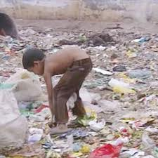
Poor & wretched Revelation 3:14-22
1.1 To the angel of the church at Laodicea
1.2 The description of the speaker
1.3 The Prophetic message – “I know…”
No commendation !
Invitation and reprimand
Divine analysis: You do not realize that you are wretched, pitiful, poor, blind and naked.

Slide 21
Poor & wretched Revelation 3:14-22
1.1 To the angel of the church at Laodicea
1.2 The description of the speaker
1.3 The Prophetic message – “I know…”
No commendation !
Invitation and reprimand
Divine analysis
Divine counsel: “I counsel you to buy from me gold refined in the fire, so you can become rich; and white clothes to wear, so you can cover your shameful nakedness; and salve to put on your eyes, so you can see”.

Slide 22
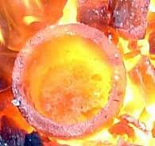
Poor & wretched Revelation 3:14-22
1.1 To the angel of the church at Laodicea
1.2 The description of the speaker
1.3 The Prophetic message – “I know…”
No commendation !
Invitation and reprimand
Divine analysis
Divine counsel
First piece of advice: - buy refined gold

Slide 23
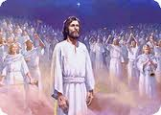
Poor & wretched Revelation 3:14-22
1.1 To the angel of the church at Laodicea
1.2 The description of the speaker
1.3 The Prophetic message – “I know…”
No commendation !
Invitation and reprimand
Divine analysis
Divine counsel
Second piece of advice - buy white clothes washed by Jesus

Slide 24
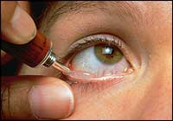
Poor & wretched Revelation 3:14-22
1.1 To the angel of the church at Laodicea
1.2 The description of the speaker
1.3 The Prophetic message – “I know…”
No commendation !
Invitation and reprimand
Divine analysis
Divine counsel
Third piece of advice - buy salve to put on your eyes

Slide 25
Poor & wretched Revelation 3:14-22
1.1 To the angel of the church at Laodicea
1.2 The description of the speaker
1.3 The Prophetic message – “I know…”
No commendation !
Invitation and reprimand
Divine analysis
Divine counsel
Reprimand and invitation: Those whom I love I rebuke and discipline. So be earnest and repent.

Slide 26
Poor & wretched Revelation 3:14-22
1.1 To the angel of the church at Laodicea
1.2 The description of the speaker
1.3 The Prophetic message – “I know…”
No commendation !
Invitation and reprimand
Divine analysis
Divine counsel
Reprimand and invitation: “The Spirit and the bride say, “Come!” And let the one who hears say, “Come!” Let the one who is thirsty come; and let the one who wishes take the free gift of the water of life” (22:17).

Slide 27
Poor & wretched Revelation 3:14-22
1.1 To the angel of the church at Laodicea
1.2 The description of the speaker
1.3 The Prophetic message – “I know…”
No commendation !
Invitation and reprimand
Divine analysis
Divine counsel - no room for personal initiatives!

Slide 28
Poor & wretched Revelation 3:14-22
1.1 To the angel of the church at Laodicea
1.2 The description of the speaker
1.3 The Prophetic message – “I know…”
No commendation !
Invitation and reprimand
There’s still hope: “Here I am! I stand at the door and knock. If anyone hears my voice and opens the door, I will come in and eat with that person, and they with me”.

Slide 29
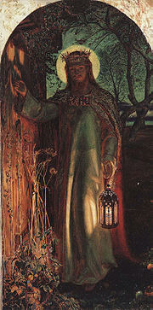
Poor & wretched Revelation 3:14-22
1.1 To the angel of the church at Laodicea
1.2 The description of the speaker
1.3 The Prophetic message – “I know…”
No commendation !
Invitation and reprimand
There’s still hope: - a condition and a promise
“Here I am! I stand at the door and knock.

Slide 30
Poor & wretched Revelation 3:14-22
1.1 To the angel of the church at Laodicea
1.2 The description of the speaker
1.3 The Prophetic message – “I know…”
No commendation !
Invitation and reprimand
There’s still hope: - a condition and a promise
“Here I am! I stand at the door and knock.

Slide 31
Poor & wretched Revelation 3:14-22
1.1 To the angel of the church at Laodicea
1.2 The description of the speaker
1.3 The Prophetic message
1.4 The Promise to the Victor
“To the one who is victorious, I will give the right to sit with me on my throne, just as I was victorious and sat down with my Father on his throne. Whoever has ears, let them hear what the Spirit says to the churches.”

Slide 32
Poor & wretched Revelation 3:14-22
1.1 To the angel of the church at Laodicea
1.2 The description of the speaker
1.3 The Prophetic message
1.4 The Promise to the Victor
2.1 Listening to the Spirit: “wretched, pitiful, poor, blind and naked”

Slide 33
Poor & wretched Revelation 3:14-22
1.1 To the angel of the church at Laodicea
1.2 The description of the speaker
1.3 The Prophetic message
1.4 The Promise to the Victor
2.1 Listening to the Spirit: “wretched, pitiful, poor, blind and naked”
Poor and needy for salvation

Slide 34
Poor & wretched Revelation 3:14-22
1.1 To the angel of the church at Laodicea
1.2 The description of the speaker
1.3 The Prophetic message
1.4 The Promise to the Victor
2.1 Listening to the Spirit: “wretched, pitiful, poor, blind and naked”
Poor and needy for salvation
I heard the voice of Jesus say, “Come unto Me and rest;
Lay down, thou weary one, lay down Thy head upon my breast.”
I came to Jesus as I was, Weary, and worn, and sad;
I found in Him a resting-place, And He has made me glad.

Slide 35
Poor & wretched Revelation 3:14-22
1.1 To the angel of the church at Laodicea
1.2 The description of the speaker
1.3 The Prophetic message
1.4 The Promise to the Victor
2.1 Listening to the Spirit: “wretched, pitiful, poor, blind and naked”
Poor and needy for salvation
Amazing grace! How sweet the sound
That saved a wretch like me!
I once was lost, but now am found,
Was blind but now I see.

Slide 36
Poor & wretched Revelation 3:14-22
1.1 To the angel of the church at Laodicea
1.2 The description of the speaker
1.3 The Prophetic message
1.4 The Promise to the Victor
2.1 Listening to the Spirit: “wretched, pitiful, poor, blind and naked”
Poor and needy for salvation
Depth of mercy can there be Mercy reaching even me? God the Just, His wrath forbears Me the chief of sinners spares!

Slide 37
Poor & wretched Revelation 3:14-22
1.1 To the angel of the church at Laodicea
1.2 The description of the speaker
1.3 The Prophetic message
1.4 The Promise to the Victor
2.1 Listening to the Spirit: “wretched, pitiful, poor, blind and naked”
Poor and needy for salvation
Poor and needy for daily life

Slide 38
Poor & wretched Revelation 3:14-22
1.1 To the angel of the church at Laodicea
1.2 The description of the speaker
1.3 The Prophetic message
1.4 The Promise to the Victor
2.1 Listening to the Spirit: “wretched, pitiful, poor, blind and naked”
Poor and needy for salvation
Poor and needy for daily life
“Hear me, O Lord, and answer me, for I am poor and needy” (Psalm 86:1)

Slide 39
Poor & wretched Revelation 3:14-22
1.1 To the angel of the church at Laodicea
1.2 The description of the speaker
1.3 The Prophetic message
1.4 The Promise to the Victor
2.1 Listening to the Spirit: “wretched, pitiful, poor, blind and naked”
Poor and needy for salvation
Poor and needy for daily life
There was a man in Jerusalem called Simeon, who was righteous and devout. He was waiting for the consolation of Israel and the Holy Spirit was upon him (Luke 2:25)

Slide 40
Poor & wretched Revelation 3:14-22
1.1 To the angel of the church at Laodicea
1.2 The description of the speaker
1.3 The Prophetic message
1.4 The Promise to the Victor
2.1 Listening to the Spirit: “wretched, pitiful, poor, blind and naked”
Poor and needy for salvation
Poor and needy for daily life
Blessed are the poor in spirit, for theirs is the kingdom of heaven (Mat 5:3)

Slide 41
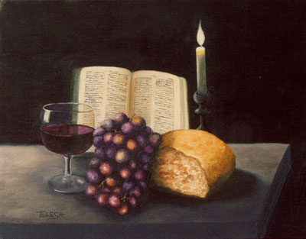
Poor & wretched Revelation 3:14-22
1.1 To the angel of the church at Laodicea
1.2 The description of the speaker
1.3 The Prophetic message
1.4 The Promise to the Victor
2.1 Listening to the Spirit: “wretched, pitiful, poor, blind and naked”
Poor and needy for salvation
Poor and needy for daily life

Slide 42
Poor & wretched Revelation 3:14-22
1.1 To the angel of the church at Laodicea
1.2 The description of the speaker
1.3 The Prophetic message
1.4 The Promise to the Victor
2.1 Listening to the Spirit: “wretched, pitiful, poor, blind and naked”
Poor and needy for salvation
Poor and needy for daily life
But grow in the grace and knowledge of our Lord and Saviour Jesus Christ. To him be glory both now and forever! Amen.

